Slide 1
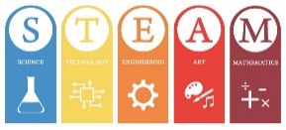
テーマ
SSⅣ 科学英語講座 濃度と反応速度の関係性
・実験の仮説を立て、実験をして検証する。・英語による説明に沿って実験をすることができる。
・濃度と反応速度の関係を理解する。 ・他の生徒と協力して、課題に取り組む。
気 づ く 力
K
起 こ す 力
O
読 む 力
Sunflower【花】
～ 応 用 ～
Y
Sprout【新 芽】
～ つながり ～
教え合う力
Seed【種】
～ 基礎知識 ～
O

Slide 2
Chemistry

Slide 3
Alchemy? 錬金術

Slide 4
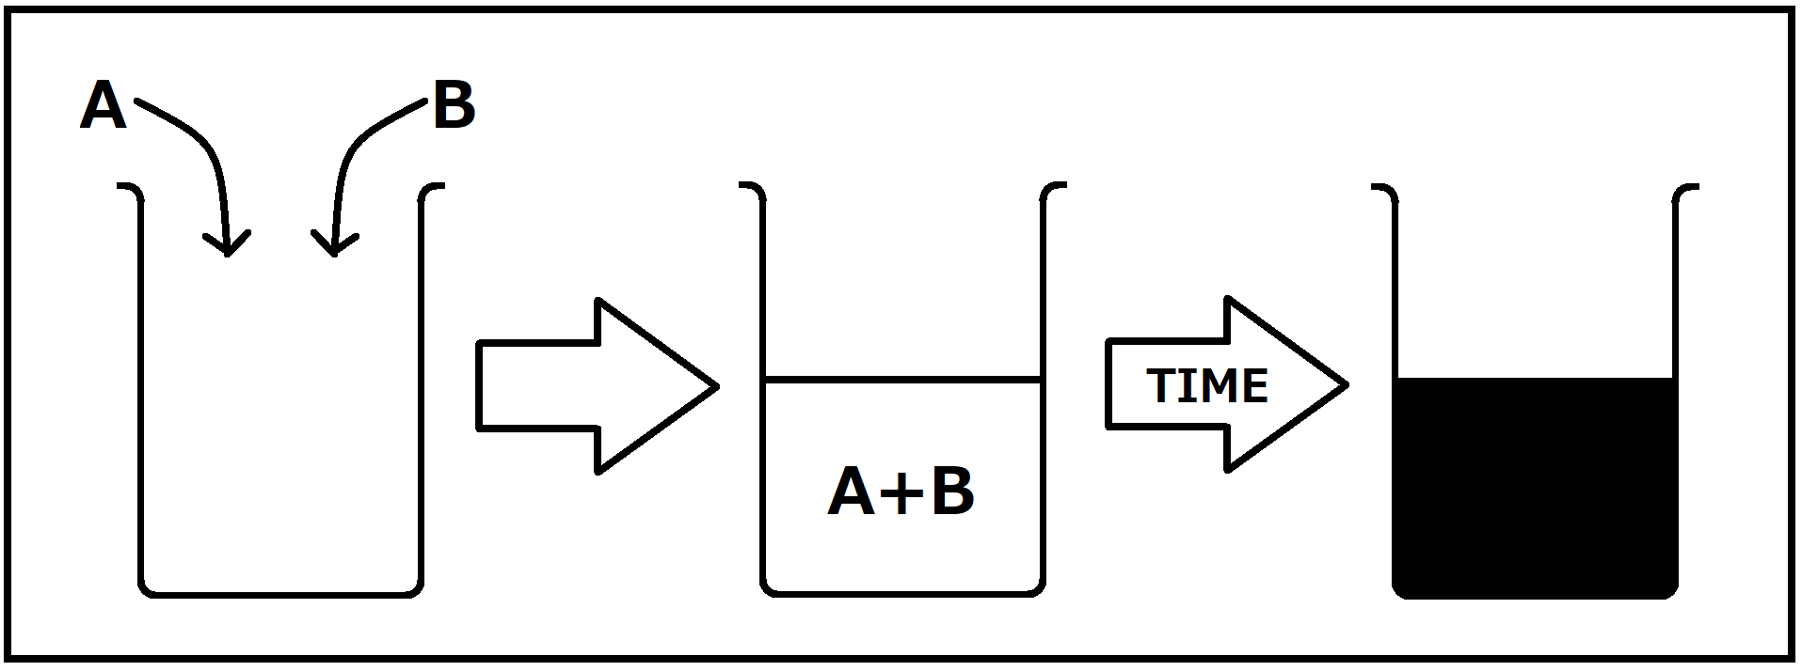
Iodine Clock Reaction ヨウ素時計反応
Many ways to do it.
Easy to see when it finishes.
Can measure reaction time clearly.

Slide 5
Rate of Reaction 反応速度
What will happen if we change the concentration?
Will the reaction be faster or slower?
How much?
Make a prediction!

Slide 6
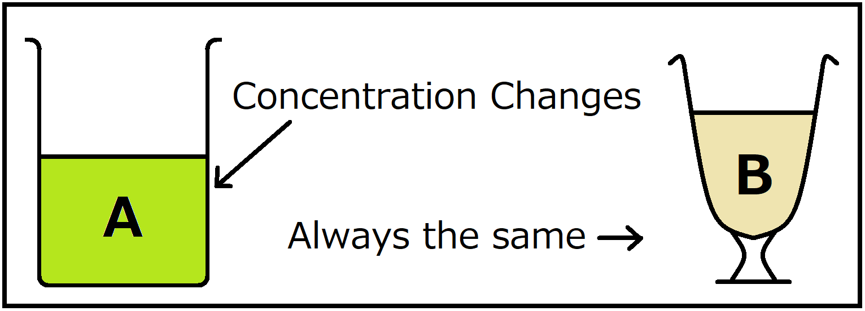
Method
We will have two solutions, A and B.
We will keep B the same for every experiment.
We will change the concentration of A.

Slide 7
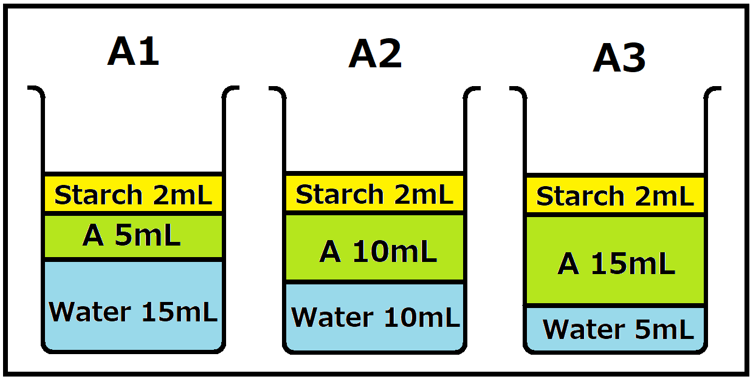
You will make 3 concentrations of A
Please measure carefully, using…
Sample | Volume of A (mL) | Volume of Water (mL) | Volume of Starch (mL)
A1 | 5 | 15 | 2
A2 | 10 | 10 | 2
A3 | 15 | 5 | 2

Slide 8
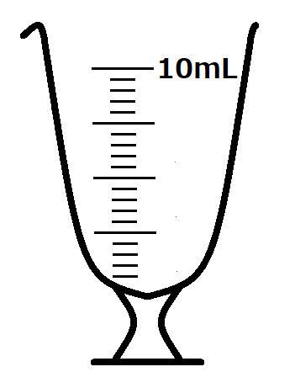
Please measure… | A | Water | Starch
Using a… | 10mL Metric Glass | 50mL Measuring Cylinder | 2mL Pipette
Which looks like…

Slide 9
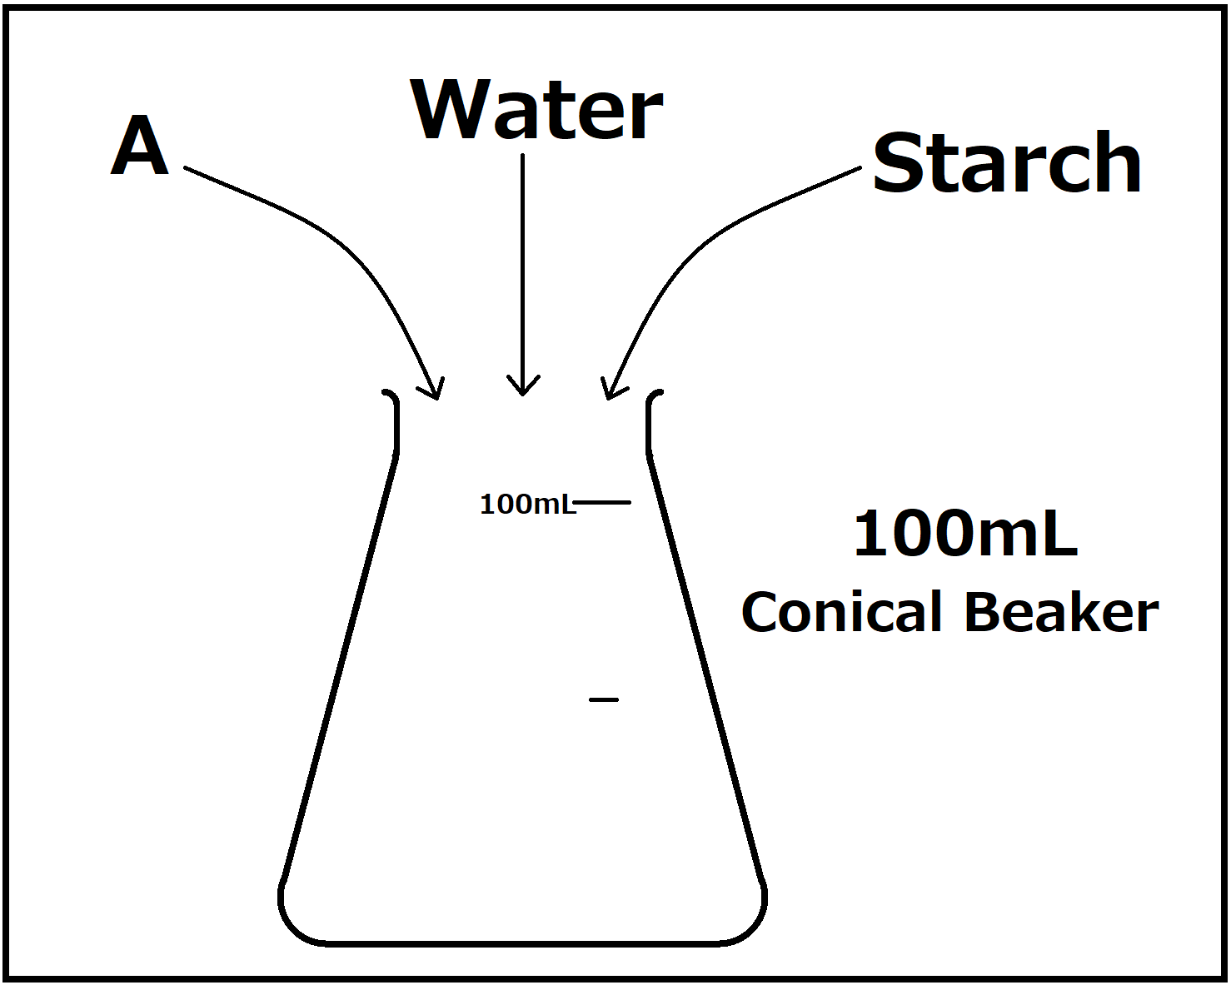

Slide 10
Please measure 10mL of B using…
A 10mL Metric Glass

Slide 11
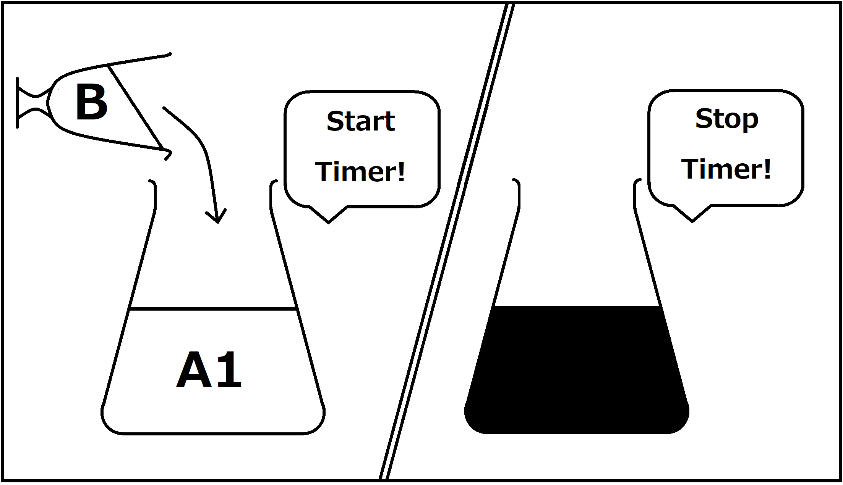
Add 10mL of B to A1 and start the timer.
Stop the timer when the mixture changes colour.
Write down the time.
Repeat for A2 and A3.

Slide 12
Experiment Time!

Slide 13
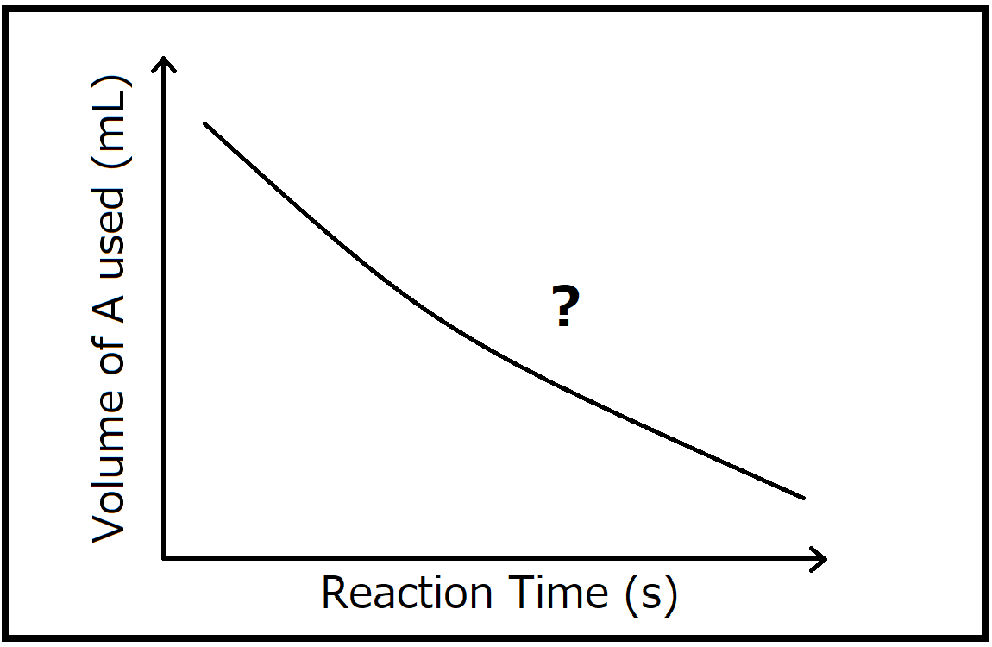
Results
Was your prediction right?
Did the results match it?
Make a graph with your results!

Slide 14
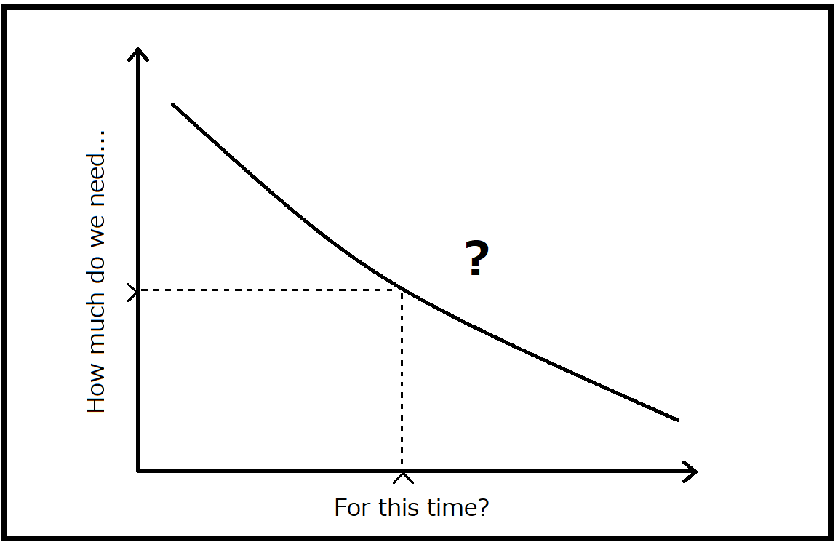
Challenge Time!
I want you to make a reaction that takes (X) seconds!!
Use your graph!
Make a solution using your results!

Slide 15
Let’s test it!

Slide 16
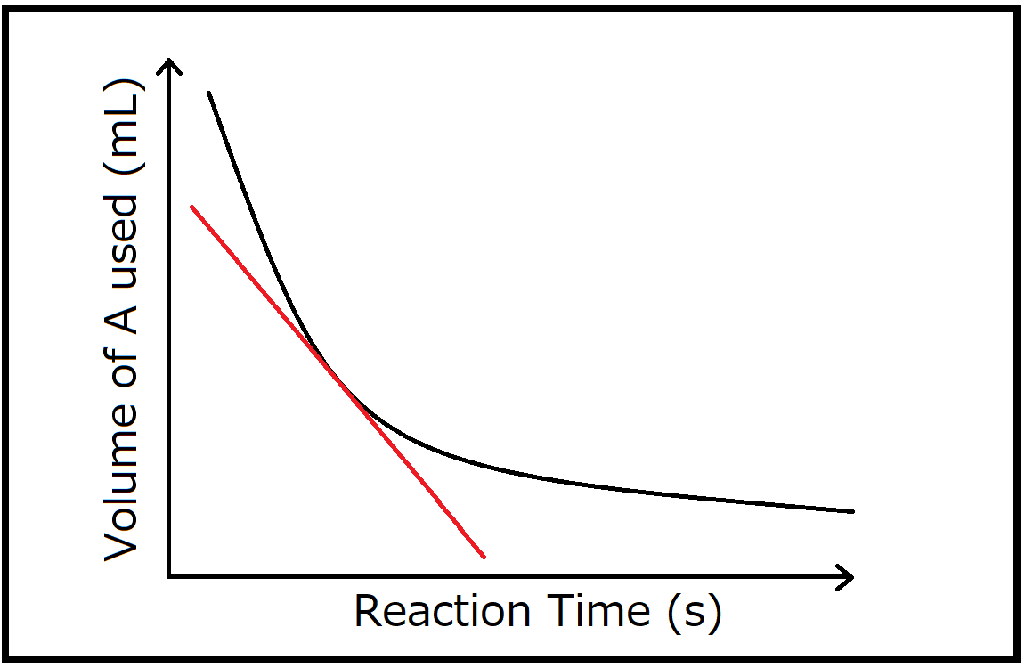
Concentration and Rate of Reaction
Increasing concentration increases rate of reaction.
If concentration doubles, the rate doubles!
Our graph shows time and volume…
But the slope, shows
how the rate changes!

Slide 17
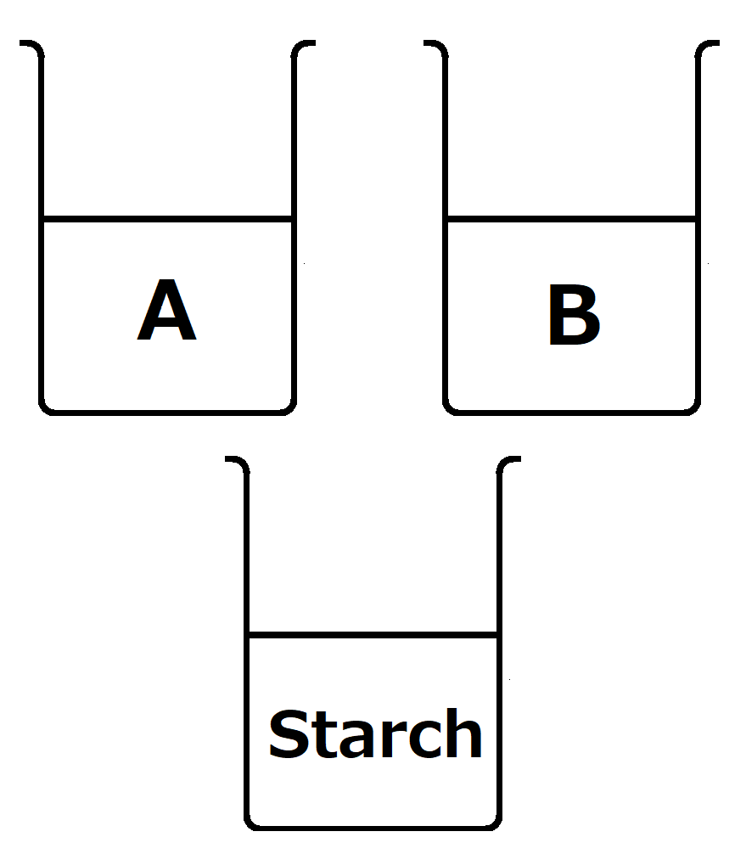
Cleaning up!
Conical Beakers | Beakers of A, B and Starch | Measuring Cylinder, Metric Glass and Pipette
-Empty into the sink. -Wash with water. -Dry with paper. -Put in tray. | -Do not empty. -Do not wash. -Put in tray. | -Do not wash. -Put in tray.

